Slide 1

CMR Technical Campus Department of CSE
Industrial Oriented Mini Project
Project Title: AI Eval: AI Driven Evaluation for Enhanced Education Using Machine Learning
Project Supervisor:​
Name:​ G. Swathi
Designation: Associate Professer
Presented By:​
Batch No: 23
H. No: 227R1A05J8 Name: T. Vaishnavi
H. No: 227R1A05G7 Name: P. Vishali​
H. No: 237R5A0520 Name: K. Shiva Krishna
H. No: 227R1A05C9 Name: Aaryan Gade
​

Slide 2
Index
Department Vision and Mission
Abstract​
Introduction​
Literature Review​
Problem Definition​
Objectives​
Requirement Analysis​
Methodology​
Design/Architecture​
References​

Slide 3
DEPARTMENT VISION:
To provide quality education and a conducive learning environment in computer
engineering that foster critical thinking, creativity, and practical problem-solving
Skills.
DEPARTMENT MISSION:
1. To educate the students in fundamental principles of computing and induce the
skills needed to solve practical problems.
2. To provide State-of-the-art computing laboratory facilities to promote industry
institute interaction to enhance student’s practical knowledge.
3. To inculcate self-learning abilities, team spirit, and professional ethics among the
students to serve society.

Slide 4
ABSTRACT:
1. Technology has transformed the education system, making learning more engaging and informative.
2. However, the evaluation process remains traditional, relying on manual correction of exam papers by teachers.
3. Machine learning and Artificial Intelligence (AI) can automate grading, reducing errors and inconvenience.
4. AI-driven evaluation systems provide personalized feedback, analyze student responses, and predict academic performance.
5. These systems offer advantages like efficiency and scalability but also raise concerns about algorithmic bias and data privacy.
6. The proposed project aims to develop an AI-based educational evaluation system, exploring its hardware and software requirements.

Slide 5
INTRODUCTION:
1. Current evaluation systems rely on manual grading by faculty, leading to errors and inconsistencies.
2. Manual grading is tedious, time-consuming, and prone to emotional bias, affecting evaluation quality.
3. This project proposes using Natural Language Processing (NLP) and Optical Character Recognition (OCR) to automate evaluation.
4. The system utilizes Google's Tesseract OCR engine and Python-tesseract to recognize and extract text from handwritten answers.
5. Automated evaluation ensures uniformity, transparency, and faster results, reducing teacher workload and minimizing human errors.
6. This system can be widely adopted in academic institutions and organizations conducting competitive examinations to streamline evaluation processes.

Slide 6
LITERATURE REVIEW
1. Manual Grading Limitations: Traditional evaluation systems rely on manual grading, which is time-consuming, error-prone, and susceptible to emotional bias (Johnson, 2003).
2. Automated Evaluation Systems: Automated systems utilizing Natural Language Processing (NLP) and Optical Character Recognition (OCR) have been proposed to address manual grading limitations (Kumar et al., 2017).
3. Effectiveness of NLP and OCR: Studies have demonstrated the effectiveness of NLP and OCR in extracting relevant information from handwritten texts (Plamondon & Srihari, 2000).
4. Machine Learning and Open-Source OCR: The use of machine learning algorithms and open-source OCR engines, such as Tesseract, has also been explored to improve evaluation processes (Smith et al., 2019).
5. Benefits of Automated Systems: Automated evaluation systems aim to provide uniform, transparent, and efficient evaluation processes, reducing teacher workload and minimizing human errors.

Slide 7
PROBLEM DEFINITION:
Educational institutions still use traditional evaluation methods like pen-and-paper methods, requiring manual reading and evaluation of answers.
Manual evaluation is time-consuming
Manual evaluation is labor-intensive and prone to variability in evaluation patterns.
There is a chance in compromising in consistency and fairness.

Slide 8
OBJECTIVES:
1. To automate the evaluation process: Using machine learning techniques to reduce manual labor and increase efficiency.
2. To standardize the evaluation pattern: Ensuring consistency and fairness in the evaluation process.
3. To decrease evaluation time: Reducing the time taken to evaluate answer papers.
4. To improve accuracy and reliability: Minimizing errors and variability in the evaluation process.
5. To enhance the overall evaluation experience: Providing a more efficient, consistent, and fair evaluation process for students and educators.

Slide 9
REQUIREMENT ANALYSIS:
Hardware Requirements:
>> Processor- i5 or above
>> RAM: 8GB
>> Storage:20GB
Software Requirements:
>> Operating System: Windows 11 or above
>> Programming language:
Frontend: HTML, CSS
Backend: Java Script, PHP, Python
>> Code Editor: Visual Studio Code
>> Web Development: PyCharm
>> Database: PHPMyAdmin
>> Local Server: XAMPP

Slide 10
METHODOLOGY:
1. Data Collection: Answer sheets are collected and scanned to convert handwritten text into digital images.
2. Optical Character Recognition (OCR): Google's Tesseract OCR engine is used to recognize and extract text from images.
3. Natural Language Processing (NLP): Extracted text is processed using NLP techniques to analyze and evaluate answers.
4. Database Design: A database is designed to store extracted answers and evaluation results, ensuring easy accessibility.
5. User Authentication : For the users register and log in using their id card number and PIN.
6. Result Analysis: The system provides unbiased results, reducing human errors and saving time and effort for teachers.

Slide 11
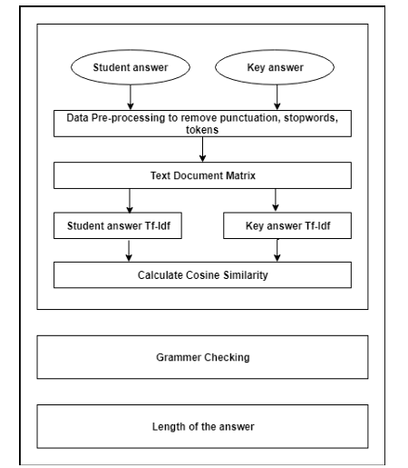
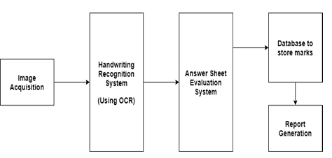
DESIGN/ARCHITECTURE:
System Design
Answer Sheet Evaluation System

Slide 12
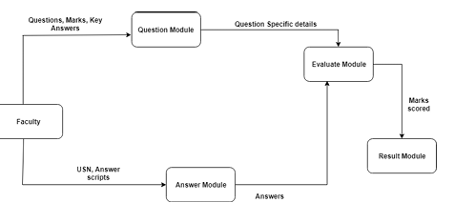
DESIGN/ARCHITECTURE
Data Flow Diagram

Slide 13
REFERENCES
Johnson, K. (2003). The impact of grading on student motivation. Journal of Educational Research, 96(4), 211-218.
Kumar, A., Kumar, P., & Gupta, S. (2017). Automated evaluation system using NLP and OCR. International Journal of Advanced Research in Computer Science, 8(3), 533-538.
Plamondon, R., & Srihari, S. N. (2000). Online and off-line handwriting recognition: A comprehensive survey. IEEE Transactions on Pattern Analysis and Machine Intelligence, 22(1), 63-84.
Smith, R., Kumar, A., & Singh, A. (2019). Tesseract-OCR: An open-source optical character recognition engine. International Journal of Scientific Research in Computer Science and Engineering, 7(3), 1-5.

